Slide 1
Module 2: Statistics for Data Analysis
Describing and Visualizing Data

Slide 2
Describing Data
Population & sample, parameter & statistic
Types of data: Categorical & Numeric
Measures of Central Tendency
Measures of Spread
Distribution Shapes

Slide 3
Key Terms
A population is the collection of all items of interest or under investigation N represents the population size
A sample is an observed subset of the population n represents the sample size
A parameter is a specific characteristic of a population
A statistic is a specific characteristic of a sample

Slide 4
Examples of Populations
Ages of all registered voters in the United States
Incomes of all families living in Daytona Beach, FL
Annual returns of all stocks traded on the New York Stock Exchange
Why do we bother with sampling?

Slide 5
Examples of Sampling
Consider a researcher for a soft drink company who wants to determine the sweetness preferences of Americans between the ages of 15 and 25.
What’s the population?
For a sample to be unbiased, it must be:
Representative of the population
Randomly selected
Sufficiently large

Slide 6
Examples of Sampling
Consider a researcher for a soft drink company trying to create a new flavor. They want to target the new flavor to the preferences of Americans between the ages of 15 and 25.
What’s the population of interest?
For a sample to be unbiased, it must be:
Representative of the population
Randomly selected
Sufficiently large

Slide 7
Types of Data
Data
Categorical
(Qualitative)
Numeric
(Quantitative)
Discrete
Continuous

Slide 8
Describing Quanitative Data

Slide 9
Measures of Central Tendency, Variance & Skew (AKA Center, Spread, and Shape)
Generally, when describing a distribution of quantitative data, the properties of center, shape, and spread give a good general overview of the key properties of the distribution. They provide a quick starting point and can inform how you interpret more detailed descriptions of the distribution.

Slide 10

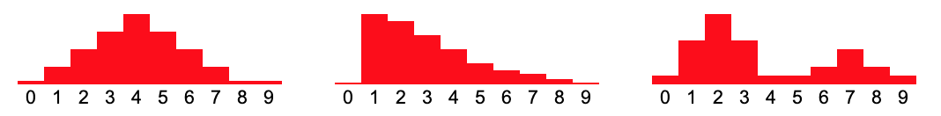
Arithmetic Mean
Key points:
Arithmetic mean = average = Sum of values / number of values =
μ = Greek letter mu = mean of a population
x̄ = x bar = mean of a sample
Is the balance point of the distribution

Slide 11
Median
Key points:
Median = middle value =
The median of a finite list of numbers can be found by arranging all the numbers from smallest to greatest.
If there is an odd number of numbers, the middle one is picked.
If there is an even number of observations, then there is no single middle value; the median is then usually defined to be the mean of the two middle values.
Is the 50th percentile
Is the 50/50 point of the distribution (equal areas)

Slide 12
Measures of Center: Key Points
Median is resistant, mean is not
Therefore mean gets pulled in the direction of skew compared to median
Additionally, mean gets pulled by extreme values, median does not. This makes median a more robust measure of center.
Explore:
http://digitalfirst.bfwpub.com/stats_applet/stats_applet_6_meanmed.html

Slide 13
Measures of Spread
Variance & Standard Deviation
IQR
Range

Slide 15

Variance & Standard Deviation
Variance is the expected value of the squared distance from the mean.
Standard Deviation is the expected distance from the mean.
𝜎 = Standard Deviation of a Population
s = Standard Deviation of a Sample

Slide 16
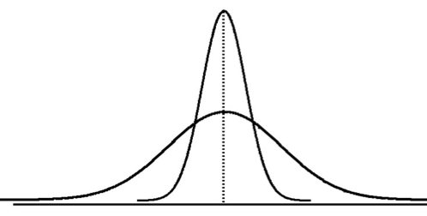
Visualizing Standard Deviation
Smaller Standard Deviation
Larger Standard Deviation

Slide 17
IQR - Interquartile Range
IQR, or Interquartile Range, is the distance between the quartiles Q1 and Q3. The quartiles occur at the 25th and 75th percentiles of a distribution. Recall that the median is the 50th percentile. So, Q1 is the median of the bottom half of the data and Q3 is the median of the top half of the data.
IQR = Q3 - Q1, so to calculate IQR, first find Q1 and Q3:
Example: 1, 2, 5, 6, 7, 9, 12, 15, 18, 19, 27
Do you think IQR is a more resistant measure of spread than standard deviation?
Notes:
Yes, IQR is more resistant. It really only depends on 2 values, so it will not be affected by extreme high or low values.

Slide 18
Range
Range is simply the distance from the minimum to the maximum value.
Range = Max - Min
Is range a robust measure of spread?
Notes:
No, range is not robust/resistant.

Slide 19
Measures of Spread: Key Points
Standard Deviation typically accompanies mean (since mean is required to calculate Standard Deviation)
Like mean, Standard Deviation is not resistant to extreme values or skew, it is calculated from every value in the data
IQR typically accompanies median (since median is required to calculate IQR)
Like median, IQR is resistant to extreme values or skew, it uses the position of values but is only calculated from 2: Q1 and Q3
Standard Deviation = √Variance Standard Deviation and IQR both have the same units as the original data

Slide 20
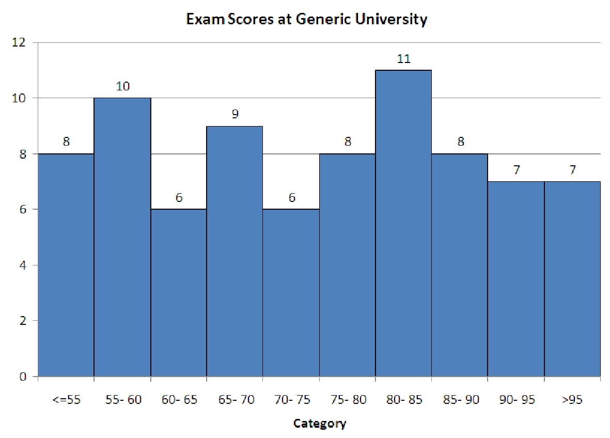
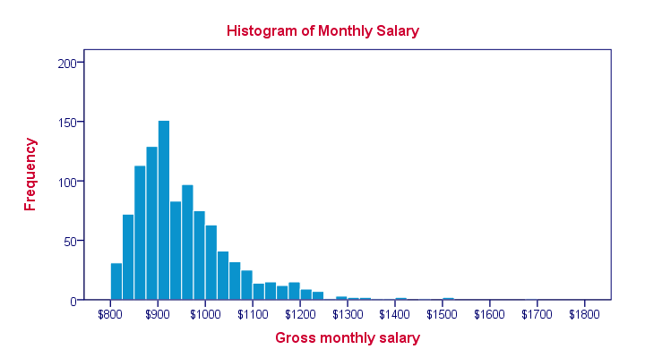
How to choose Mean/St Dev. vs. Median/IQR
Generally we prefer to report mean and standard deviation, unless a data set has many extreme values or significant skew, because mean and standard deviation take into account all values in your data set. Examples:

Slide 21
Shape
Symmetry or Skew
Peaks (Unimodal, bimodal, bell-shaped)

Slide 22
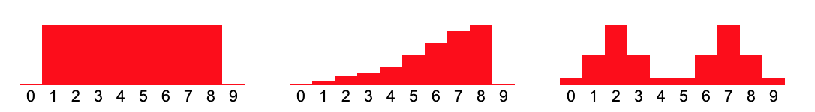
Symmetry and Skew
Data can be symmetric, if the left half and right half follow roughly the mirror distribution of each other.
When they are displayed graphically, some distributions have many more observations on one side of the graph than the other. Distributions with fewer observations on the right (toward higher values) are said to be skewed right; and distributions with fewer observations on the left (toward lower values) are said to be skewed left.

Slide 23
Peaks (Unimodal, Bimodal, bell-shaped)
Distributions can have few or many peaks. Distributions with one clear peak are called unimodal, and distributions with two clear peaks are called bimodal. When a symmetric distribution has a single peak at the center, it is referred to as bell-shaped.

Slide 24
Visualizing Data
Goals for visualizing data
Categorical display types (Frequency Distribution Table, Bar Chart, Pie Chart)
Numeric display types (Histogram, Box Plot, Scatter Plot, Line Chart)

Slide 25
Goals for Presenting Data Graphically
Data in raw form are usually not easy to use for decision making
Some type of organization is needed (table, graph)
The type of graph to use depends on the variable being summarized
General goals for effective data presentation:
Present data to display essential information
Communicate complex ideas clearly and accurately
Avoid distortion that might convey the wrong message

Slide 26
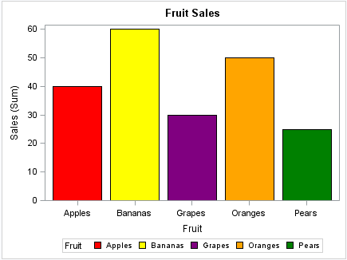
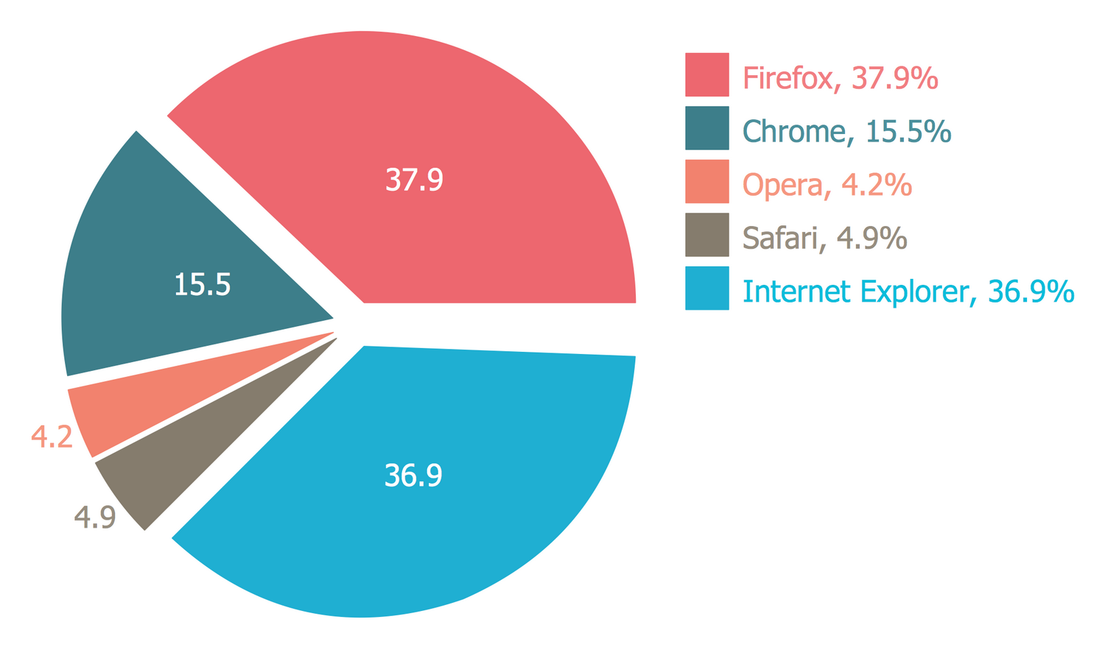
Common Display Types
Favorite Color | Frequency
Magenta | 4
Cerulean | 2
Black | 9
Categorical:
Frequency distribution
Bar chart
Pie chart

Slide 27
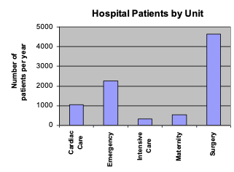
Frequency Distribution Table
Key Vocabulary:
Frequency = Count = Number of Occurrences
Hospital Unit | Number of Patients
Cardiac Care | 1,052
Emergency | 2,245
Intensive Care | 340
Maternity | 552
Surgery | 4,630
Notes:
Often the first display used when making other displays by hand
Without doing any other calculations, what kind of display could you make?
Careful to remember that ordering of categories does not imply value!

Slide 28
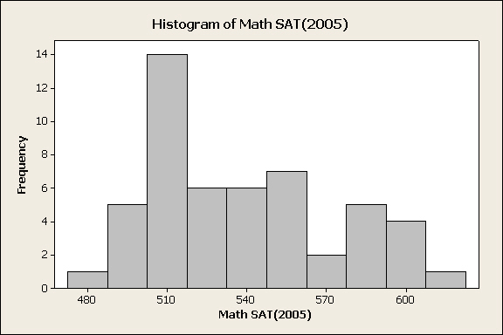
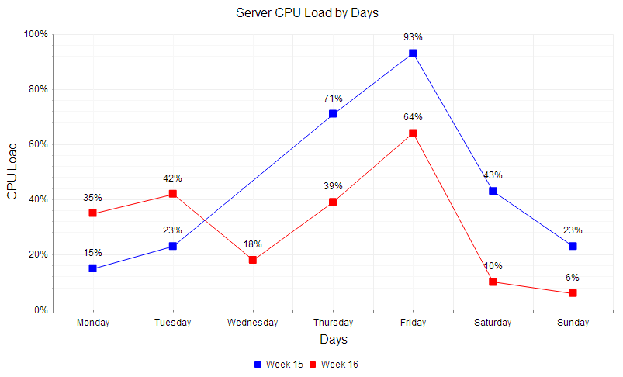
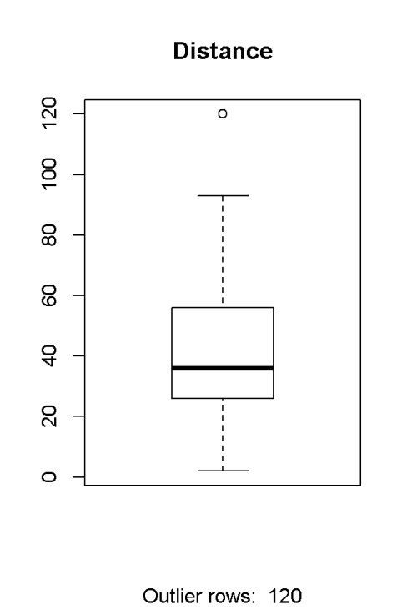
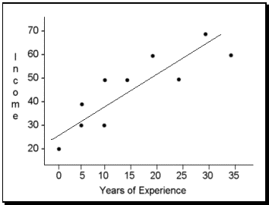
Common Display Types
Quantitative:
Line chart
Histogram
Boxplot
Scatter plot
Notes:
Important: When neighboring values are connected, it indicates a relationship. When they are disconnected, it implies no relationship. That’s why on Bar Charts the bars do not touch, but on Histograms they do.

